Slide 1
Clustering Cities in india
Aneel Kumar

Slide 2
1.Introduction
India is the second largest country in the world after China .There are 4000 cities and towns in India .About 300 cities have population over 1,00,000 Seven cities have population more than 3 million .Greater Mumbai still is the most populated city in its 440sq.Km. area followed by Delhi, Kolkata ,Bangalore and Chennai.
In this project over 150 cites data are collected from different web sources and use it for clustering cities in India. These cities are clustered on basis of the venues in the city. By this we can show same kind of cities on basis venues in it.

Slide 3
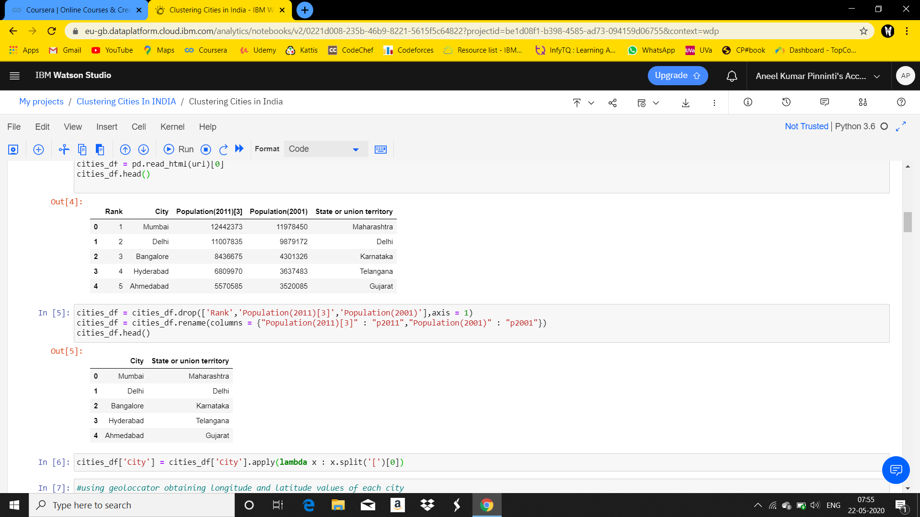
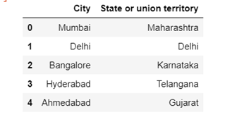
2.About the data
Obtained data from Wikipedia using
read_html function
Removed unnessary columns from data frame.

Slide 4
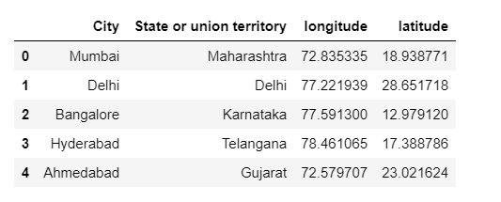
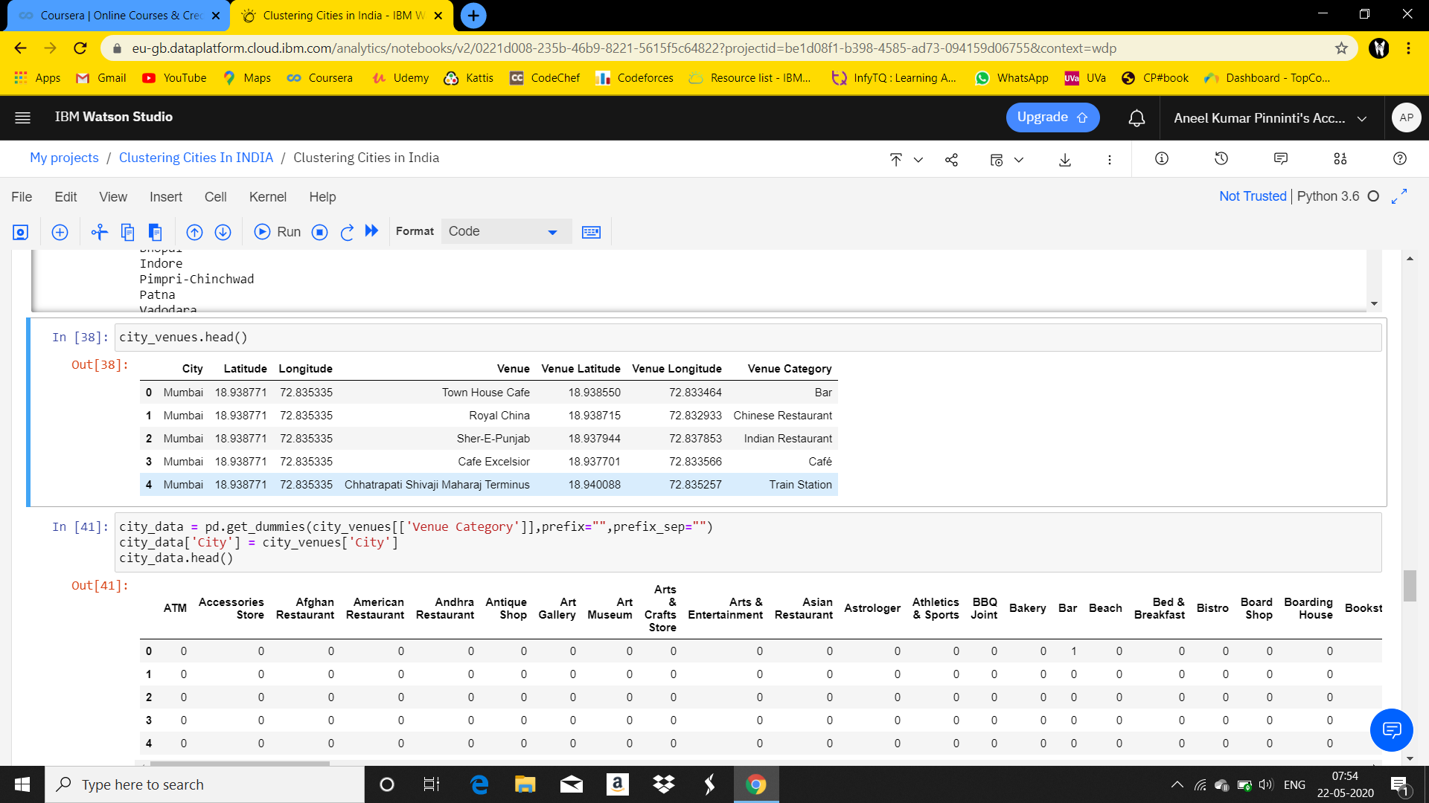
Using Geolocator we added longitude and latitude data to the dataframe
Using FourSquare api obtained venues in each city.

Slide 5
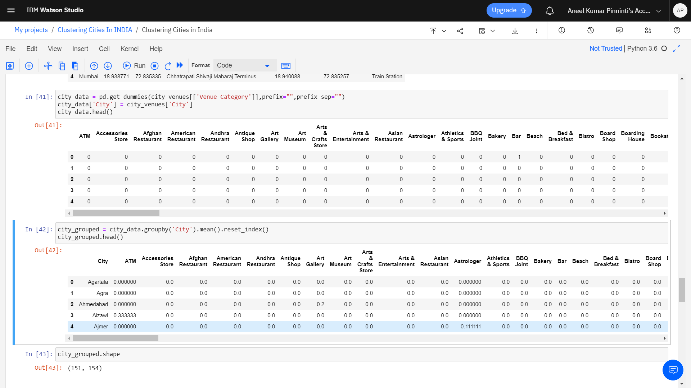
Converted data frame to categorical on basis of venue categories
This data frame is then grouped by cities with function mean

Slide 6
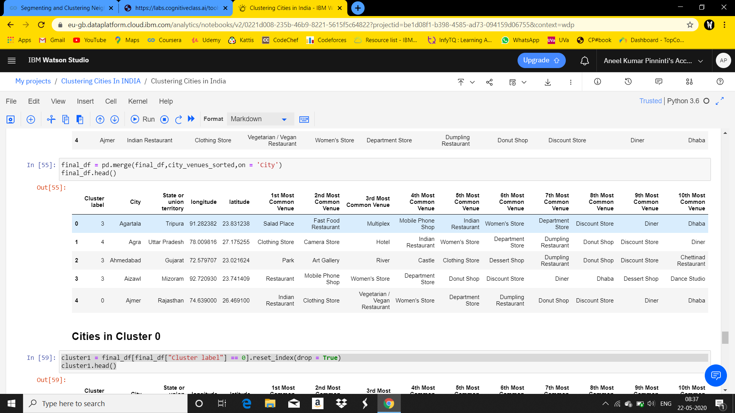
3.Modeling
Using K-means clustering algorithm the cities are clusterd into 5 clusters and added clustered labels to data frame.
Then added top 10 venues in each city to the data frame

Slide 7
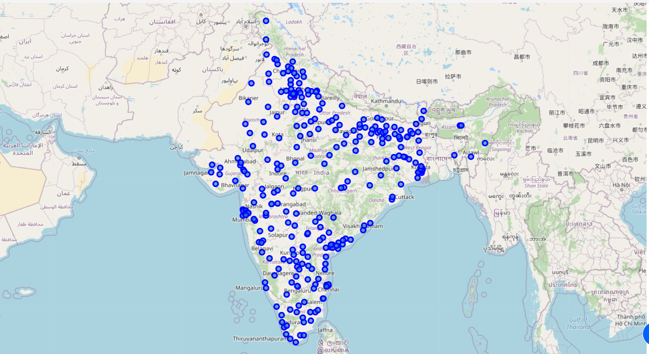
4.Visualising
Map showing Cities in India using Folium

Slide 8
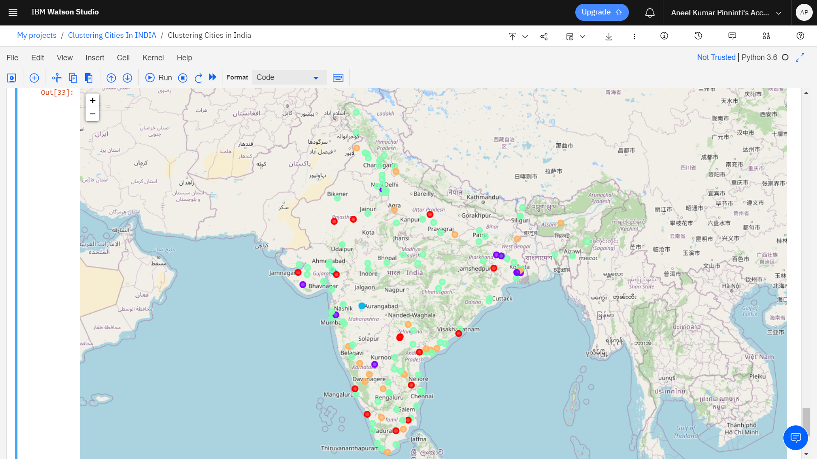
Map showing cities marked with coloured points according to their cluster label

